Slide 1
St Mary’s Advisory Meeting
29.10.21
Julie Marker with PPC

Slide 2

Remind Reflect Respond
Mission and Ministry
For such a time as this…

Slide 3
MINT – Mechanisms, Impact, Need, Trust.
Mechanisms
Contactless giving
Online giving
Gift aid
Fair share

Slide 4
MINT – Mechanisms, Impact, Need, Trust.
Impact
To continue our mission to go into the world and make disciples
To have a meaningful presence in our community

Slide 5


MINT – Mechanisms, Impact, Need, Trust.
Need
Church family
Community
Embedded into fabric of society

Slide 6
MINT – Mechanisms, Impact, Need, Trust.
Trust
Ethical
Honourable
Faithful
Compliance with Code of Fundraising Practice

Slide 7
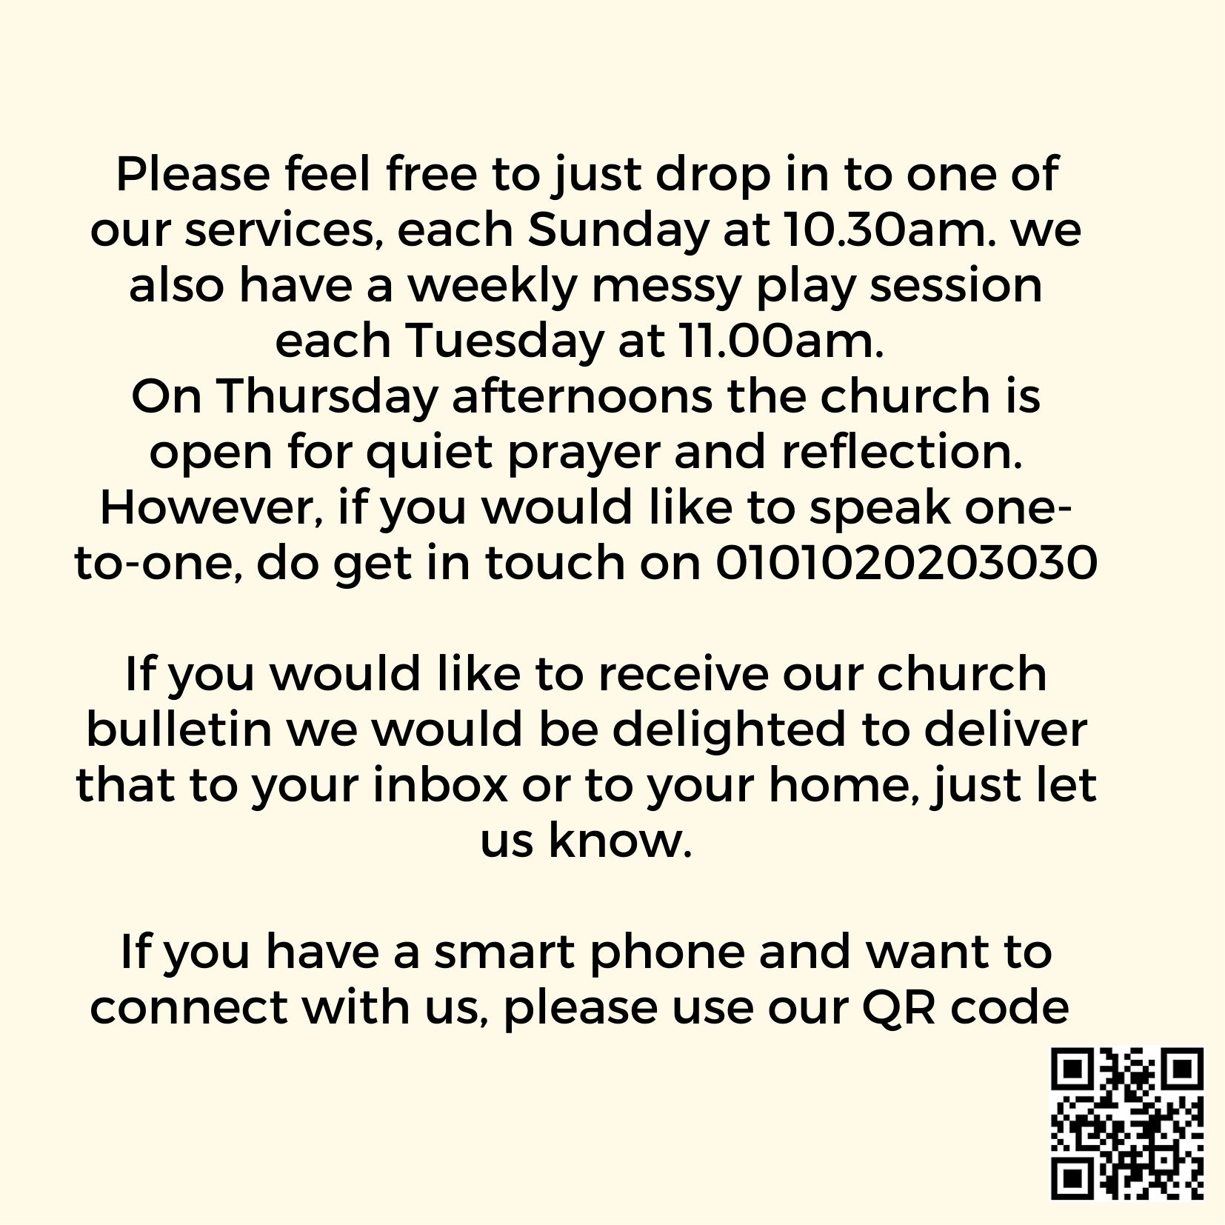

Community outreach

Slide 8






Action Points
Prayer and reflection
Action Plan
Explore gifts, skills, experience that can be utilised for mission
Congregation respond and commit to generosity in time, talents and treasure
Digital mechanisms in place
Align activity with goals needed for sustainability
Outreach activity
Reach goal
IDEA – Culture of Generosity
We are here – Even in pandemic Inspire, Disciple, Embed, Activate
Photographs of people at Church
Hall hire – community hub – invite suggestions
Celebrate achievements
Achieve 100% of Parish share

Slide 9
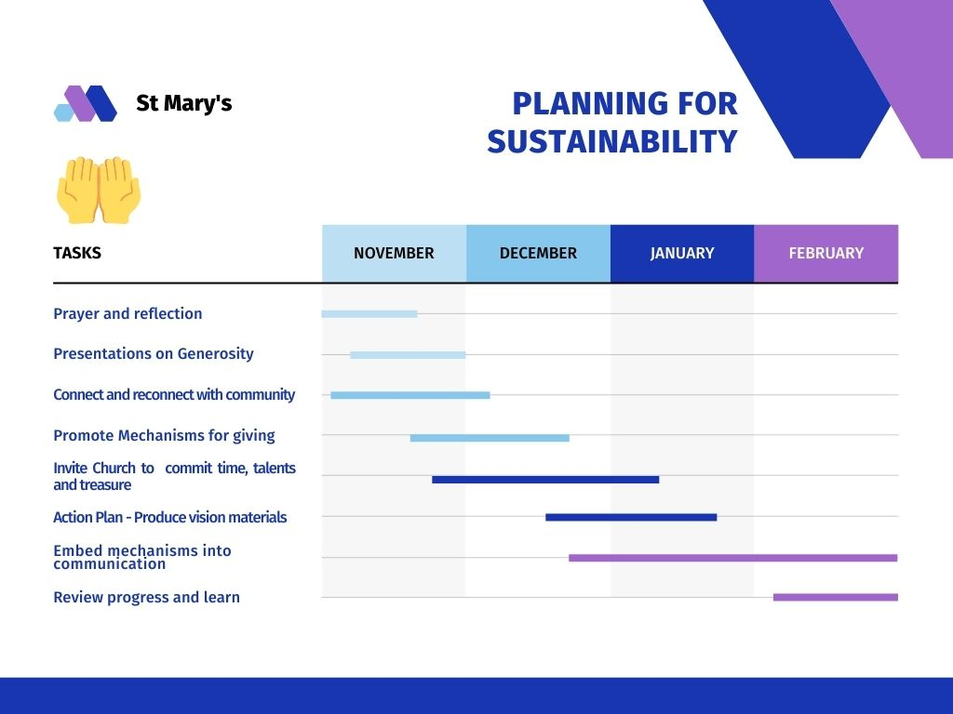

Slide 10
Time, Talent, Treasure
1. Connect with community through inviting them to share their local photographs, if in the church or hall even better! Invite them to share their story around it.
Purpose – Connect Church with community
Then - With permission, compile into a booklet to be distributed later.
Purpose – Reminder of the positive presence of the church.
2. Plan a ‘re-use’ day
Purpose - to demonstrate a commitment to the environment and sustainability.
Then - organise a ‘donate three items’ Clothing, toys or household – the sale of the items will be donated to a local charity. We sell items for reasonable prices and donate unsold items to charity shop.
3. Plan a digital market day for local businesses’ to showcase their products
Purpose – To connect with people and organisations in our community
Then – Ask them to donate one item (they don’t pay for a ‘stand’) and run a silent auction in aid of a specific Church need. Follow up with a celebration of their generosity.

Slide 12
Purpose – Mission, Ministry and Purpose
Blessing each other and our community
Light and hope
Supportive
Spirit of Generosity
“Is not this the kind of fasting I have chosen: to loose the chains of injustice and untie the cords of the yoke, to set the oppressed free and break every yoke? Is it not to share your food with the hungry and to provide the poor wanderer with shelter?... If you do away with the yoke of oppression, with the pointing finger and malicious talk, and if you spend yourselves on behalf of the hungry and satisfy the needs of the oppressed, then your light will rise in the darkness and your night will become like the noonday. The Lord will guide you always.” – Isaiah 58, 6-11 (NIV)

Slide 13
Thank you How can I support you?

